Slide 1


Library business
Team 4

Slide 2

Mission
We are an agency in charge of helping you create your business, you have the idea and we do the market research, the design of your brand and we help you lay the foundations for your beginnings
Who we are?
Vision
To be the number one company in helping entrepreneurs start their business and establish the foundations of what will one day be great companies
Values
As the meaning of our company, our number one value is to guide entrepreneurs to form their business according to their ideals and budget.

Slide 3

One of our clients
Legere
72 %
Mexican adults read

Slide 4
Market Study
Which book they should have in their library
54728
7000
We will join these two databases to form one with relevant information about the books and their rating, in order to determine if a book will be successful or not.
records
records
GoodReads Best Books Ever
Soumik's Goodreads-books dataset
The base comes from a book page where users from all over the world rate the books
The data set has characteristics of any books as title, author, description, rating and more

Slide 5
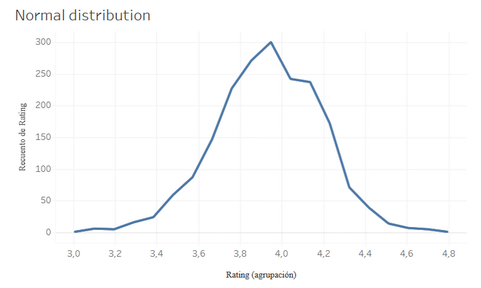
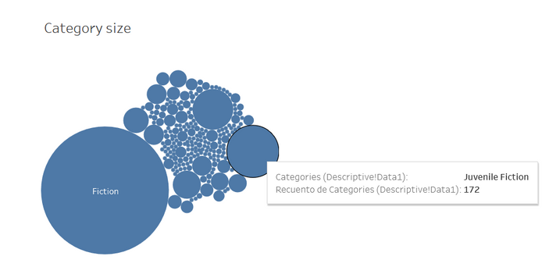
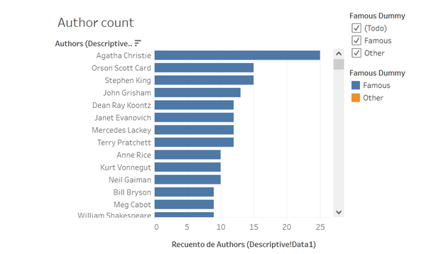
We can trust this study market?
Normal distribution
Category size
Authors
We can tell if a book will be successful or not based on their author
The result will reliable
We can group the books
https://public.tableau.com/views/Mockupteam4library/Historia1?:language=es-ES&publish=yes&:display_count=n&:origin=viz_share_link

Slide 6
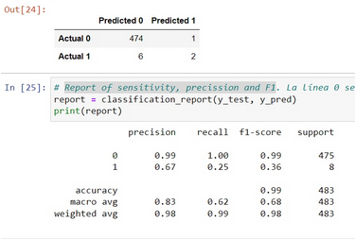
What we get
Machine learning analysis
We use logistic regression
We have an accuracy of 98 percent, so we can trust that the books we select as the best will be successful and sell very well in our client's bookstore.

Slide 7
Intercative
mockup

